Slide 1
Introduction
to
Microsoft PowerPoint 2010

Slide 2
Editing Presentation in Word 2010

Slide 3
Objectives Overview
How to copy and paste content
How to Find & Replace content
How to Undo Edited changes
How to do spelling Check
How to do content Translation
How to set language type
How to duplicate content
How to add special characters
How to add special characters
How to do zoom in-out

Slide 4
Copy and Paste Content in PowerPoint 2010
PowerPoint offers to the users a wide range of options when it comes to duplicating content.
PowerPoint has the standard cut and copy functions but allows variations of paste options.

Slide 5
Cut Option
This option allows you to cut content from the slide - this means the original content is being moved to a different location hence the content will be deleted from its original location when you use this option.
To cut a content, you need to select it and press "Ctrl + X" or right-click on the selected content and select Cut.

Slide 6
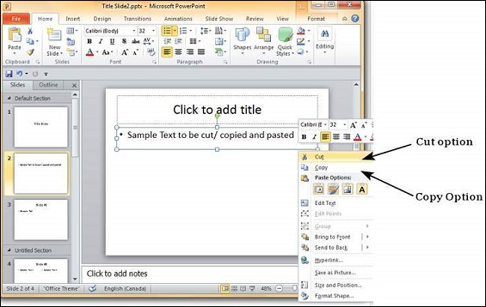
Cut Option

Slide 7
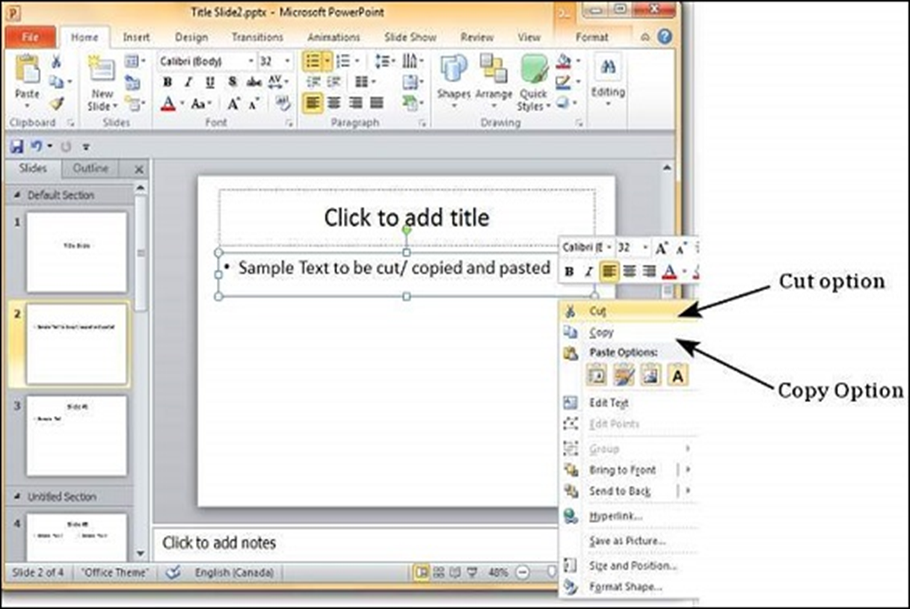
Copy Option
To copy a portion of content, you need to select it and press "Ctrl + C" or right-click on the selected content and select Copy.

Slide 8
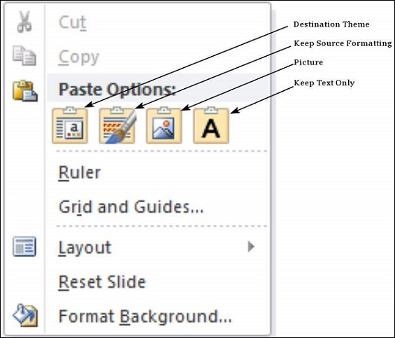
Paste Option
This option allows you to paste the cut or copied content at the desired location.
There are multiple paste options for you to choose from.

Slide 9
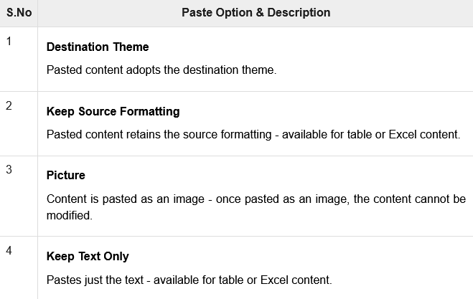
Paste Option

Slide 10
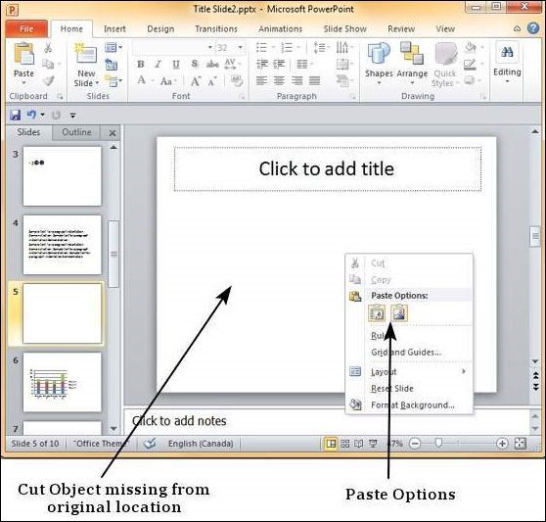
Paste Option

Slide 11
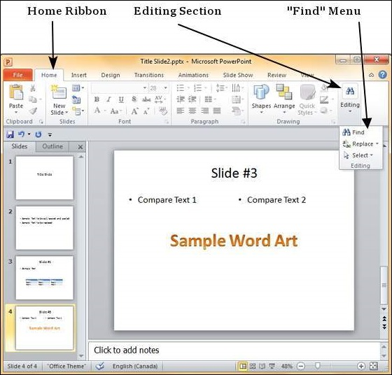
Finding Content
Step 1
In the Home tab, under the Editing section click on Find.

Slide 12
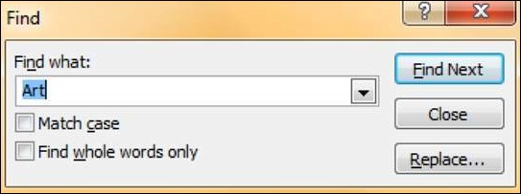
Finding Content
Step 2
Type the text you want to search in the "Find what:" field.

Slide 13
Finding Content
Step 3
You can narrow your search by selecting "Match Case" - to find exact case match - and "Find whole words only”
Step 4
Press on "Find Next" to find the next occurrence of the search word.

Slide 14
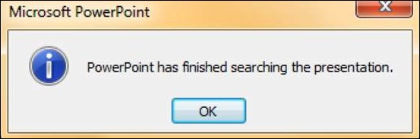
Finding Content
Step 5
The Find dialog does not disappear after finding the first instance,
so you can keep pressing "Find Next" multiple times till you reach the end of the search.
At this point, you will receive a message from PowerPoint indicating the end of the search.

Slide 15
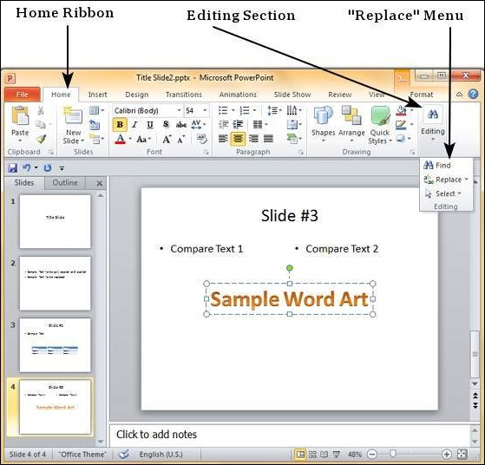
Replacing Content
Step 1
In the Home tab, under the Editing section click on the Replace button.

Slide 16
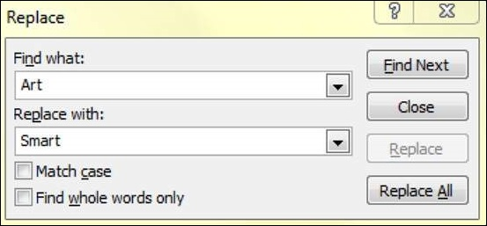
Replacing Content
Step 2
Type the text you want to replace in the "Find what:" field and the replaced text in "Replace with:" field.

Slide 17
Replacing Content
Step 3
You can narrow your search by selecting "Match Case" - to find the exact case match - and "Find whole words only“
Step 4
Press on "Find Next" to find the next occurrence of the search word.
PowerPoint will show you the next occurrence and you can then click on "Replace" to replace the word.

Slide 18
Replacing Content
Step 5
The Replace dialog does not disappear after finding the first instance,
so you can keep pressing "Find Next" multiple times till you reach the end of the search.
At this point, you will receive a message from PowerPoint indicating the end of the search.

Slide 19
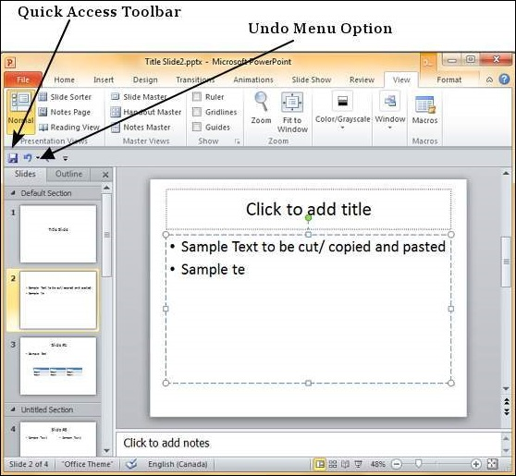
Undo Edited Changes in PowerPoint 2010
To undo the last action, click on the Undo button in the PowerPoint Quick Access bar.

Slide 20
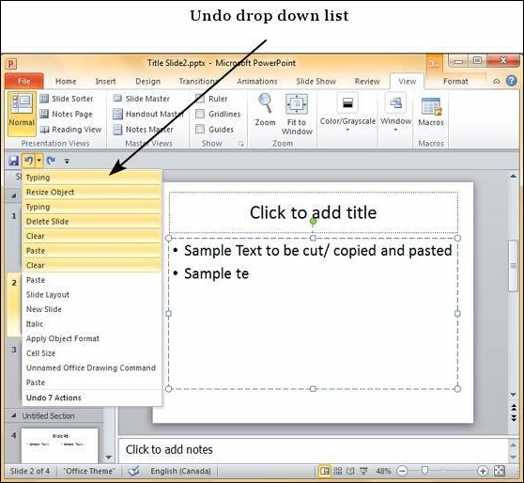
Undo Edited Changes in PowerPoint 2010
You can keep clicking on this button repeatedly to undo the series of actions; however a more graceful way of undoing multiple actions is to use the dropdown next to the undo button.
Here you can select the list of actions you want to undo by sliding your cursor on top of the actions and click on them.

Slide 21
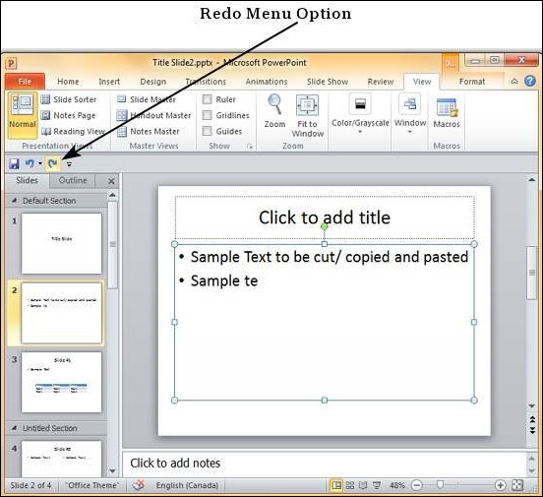
Redo Edited Changes in PowerPoint 2010
Redo is an option available only after you have undone at least one action.
The redo follows the same logic as the undo option, except in the reverse order.

Slide 22
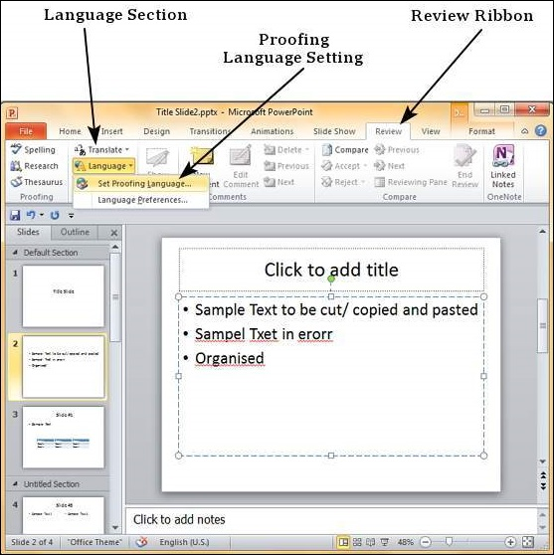
Spelling Check in PowerPoint 2010
To use this feature, you need to first set the Proofing language from the Language section under the Review ribbon.

Slide 23
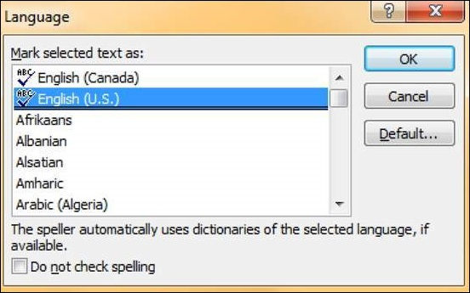
Spelling Check in PowerPoint 2010
In the Language dialog, you can select the language you want to use for your presentation.
If you want to use the selected language for the entire presentation you should click default.

Slide 24
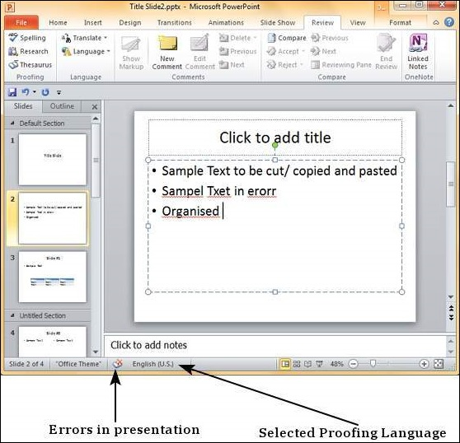
Spelling Check in PowerPoint 2010
Once the proofing language is set you can see it at the bottom of the PowerPoint window.
If there are proofing errors in the presentation, you will also see an icon of a book with a red cross on top of it.

Slide 25
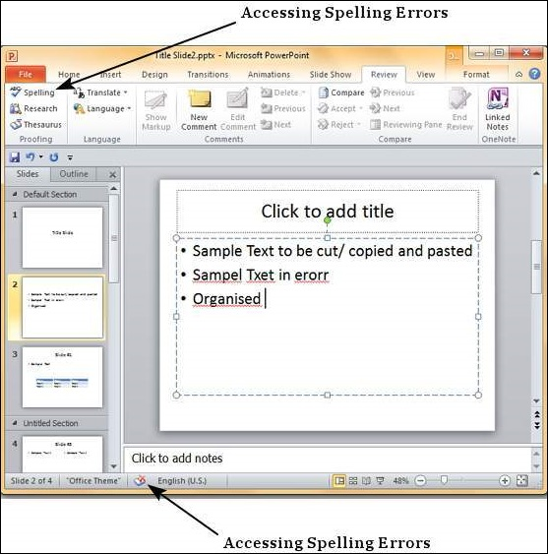
Spelling Check in PowerPoint 2010
You can review the errors in the presentation by clicking on the red cross at the bottom of the window or
by clicking on "Spelling" under the Proofing section in the Review ribbon.

Slide 26
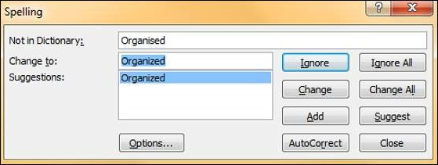
Spelling Check in PowerPoint 2010
From the Spelling dialog, you can take the necessary actions to ignore, correct or edit the errors in the presentation.
The table below describes the various options you have in the Spelling dialog.

Slide 27
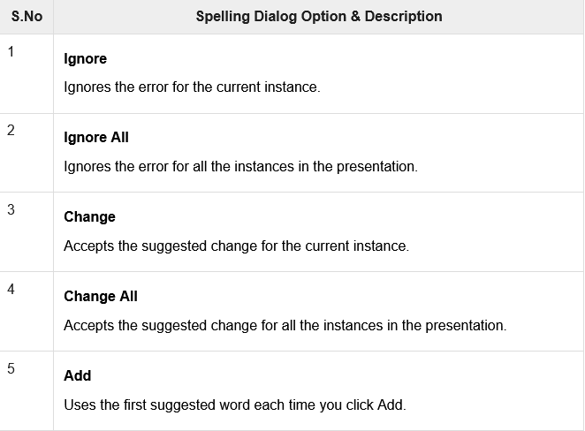
Spelling Check in PowerPoint 2010

Slide 28
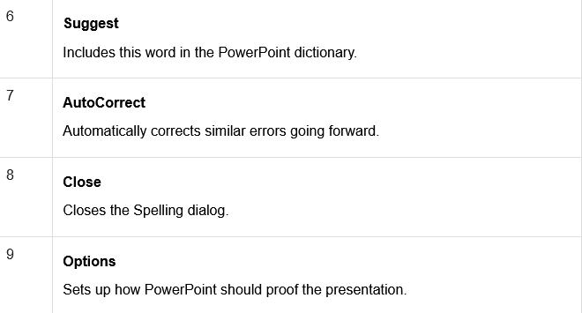
Spelling Check in PowerPoint 2010

Slide 29
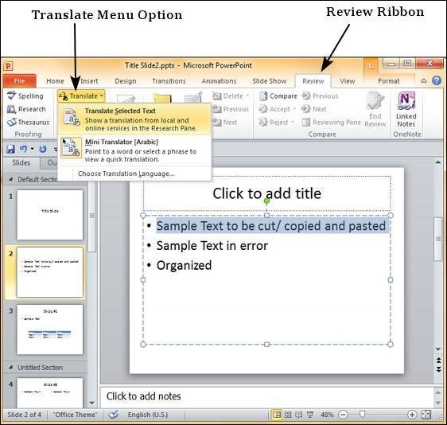
Content Translation in PowerPoint 2010
This feature in PowerPoint allows you to select content and have it translated into a different language.
Step 1
Select the text to be translated and click on Translate - Translate Selected Text under the Language section of the Review ribbon.

Slide 30
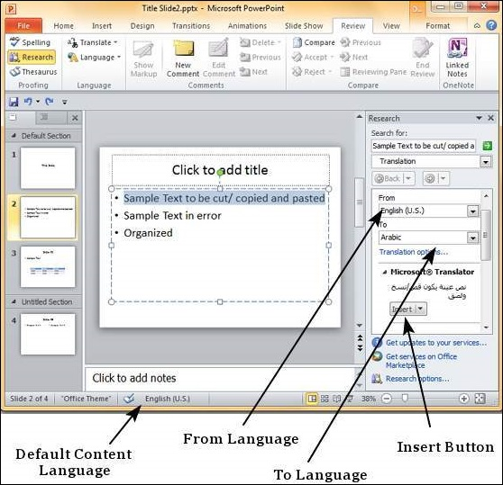
Content Translation in PowerPoint 2010
Step 2
In the research sidebar, the "From" language is set to default language settings for the content.
The "To" language is set to the alphabetically first language supported by PowerPoint.

Slide 31
Content Translation in PowerPoint 2010
Step 3
From the "To" language dropdown, select the language you want the selected portion of text translated into.
Click on Insert to replace the selected text from the default language to the new translated text.
NOTE: Your PC should be connected to the internet.

Slide 32
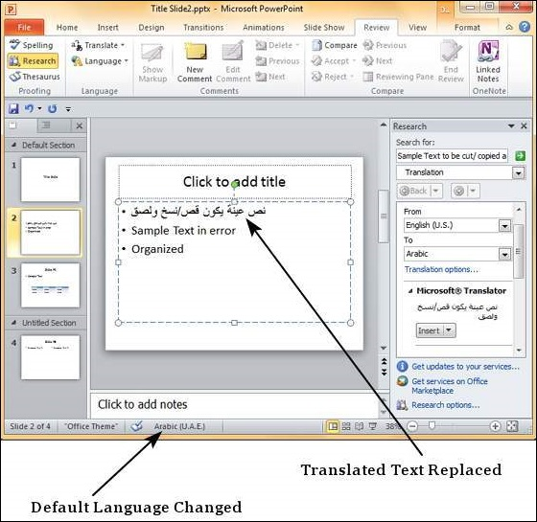
Content Translation in PowerPoint 2010
Step 4
Notice that if you replace the portion of text using translation, the default language for the replaced text also changes automatically.

Slide 33
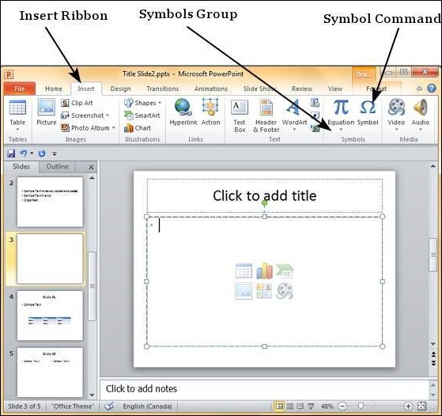
Special Characters in PowerPoint 2010
Step 1
In the Insert Tab, under the Symbols group, click on the Symbol command.

Slide 34
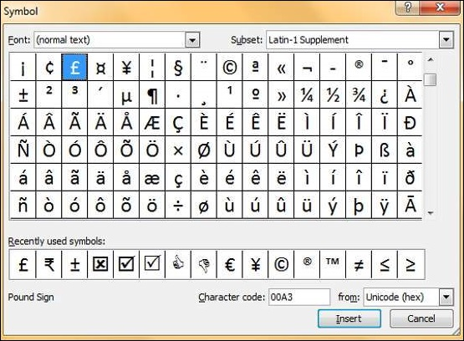
Special Characters in PowerPoint 2010
Step 2
In the Symbol dialog, select one of the special characters you want to insert in the presentation.

Slide 35
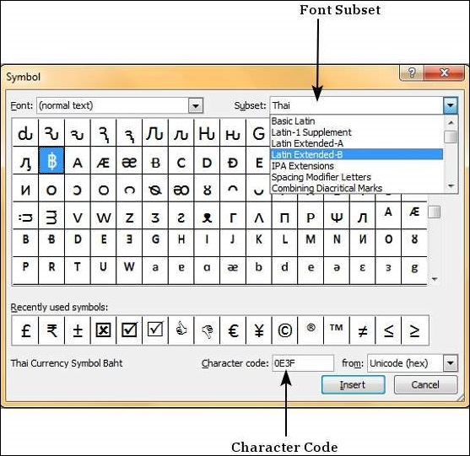
Special Characters in PowerPoint 2010
Step 3
If you cannot find the character you are looking for, you can change the font subset from the dropdown and look at a new set of characters.

Slide 36
Special Characters in PowerPoint 2010
Step 4
If you know the character code of the symbol, you can enter it in the Character Code field and search for it.
Step 5
To insert a character, you can either double-click on it in the Symbol dialog or,
Select it and press the Insert button.

Slide 37
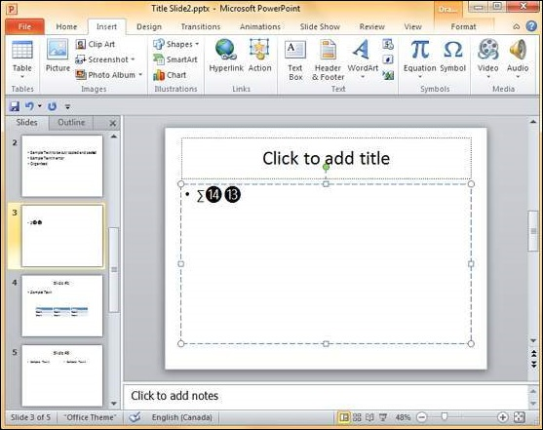
Special Characters in PowerPoint 2010
Step 6
Once you are done, you can click Close to close the dialog.

Slide 38
Slides Zoom In-Out in PowerPoint 2010
PowerPoint allows users to zoom in and zoom out of the slides to help focus on specific sections or look at the entire slide as a whole.
The minimum zoom supported by PowerPoint is 10% and the maximum is 400%.
The zoom bar is located in the bottom right corner of the PowerPoint window.

Slide 39
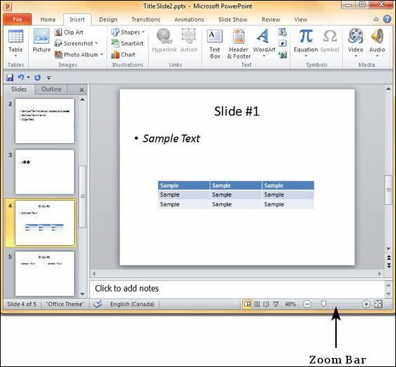
Slides Zoom In-Out in PowerPoint 2010

Slide 40
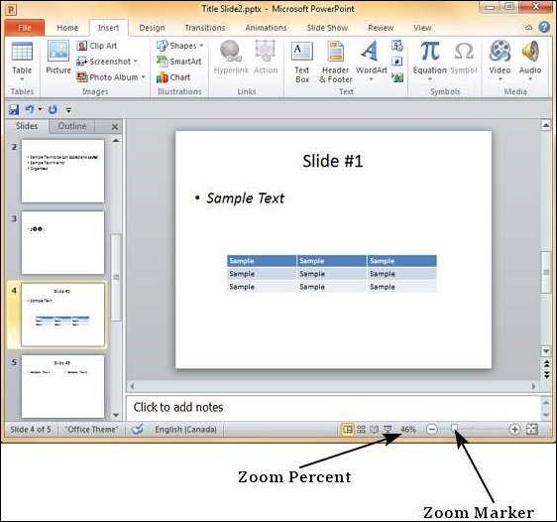
Slides Zoom In-Out in PowerPoint 2010
To change the zoom settings from the zoom bar, you can
Click on the marker and drag it.
Dragging to the left will zoom out and to the right will zoom in.

Slide 41
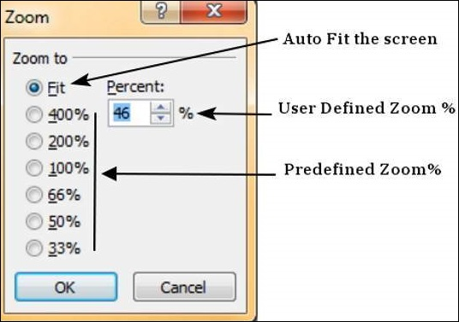
Slides Zoom In-Out in PowerPoint 2010
Alternately, you can click on the zoom percent to open the zoom dialog.
Here you have the option to auto-fit the slide in the screen, or choose from six pre-defined zoom settings, or define your own zoom setting.

Slide 42


Slide 43
THANK YOU

